Slide 1






IEEE CIS Hackathon
(Organized BY MNIT,Jaipur)
Sponsors
Team Name : ASI-J1
Team Leader :
Team Member :
Gaurav Rathore
Aditi Agarwal
Problem :
Statement
AI-based career counselling from
class 10th to college level students
College Name:
Government Engineering College Ajmer

Slide 2
Objectives
To make AI support Counsellor in recognizing counselee’s strengths and weaknesses, enabling counselee development
Supporting career planning , decision making throughout career, promoting available career services based on situational information through AI
Comparing competences to goals and needs from working life , offering self assessment tools for competence mapping, inferring competence gaps based on profile data
Enhancing interaction in counselling: matching students and counsellors, collating previous guidance discussions to a knowledge base

Slide 3
Can be used by vast amount of student
Career Guidance rate will increase by 25% or more
Educational level will increase
Novelty
Help Individual acquire the knowledge, information, skills, and experience necessary to identify career options, and narrow them down to make one career decision
User have access to a wider range of counselors with different backgrounds, expertise, styles, and perspectives

Slide 4
Complexity
Technical Complexity : It requires a High Performance System for NLP, Machine Learning Model, Security and Privacy. The system needs to understand the semantic meaning of the user's queries
User Experience : Creating an intuitive and user-friendly interface that seamlessly integrates AI-driven recommendations with human interaction requires expertise in user experience (UX) design and frontend development.
Feedback Loop: Implementing a feedback mechanism that allows the system to learn from user interactions and refine its recommendations over time requires sophisticated data collection, analysis, and model updating.
Scalability and Performance Complexity : Designing the system to handle a large number of users and provide real-time recommendations without compromising performance is challenging
Data and Analytics Complexity : Storing Large Dataset in Cloud for easy accessibility across a large area.
And Integrating diverse sources of data

Slide 5
Feasibility
AI - Career Counselling will ensure an increased reliability, faster response, unemotional and steady results through Artificial Neural Networks (ANNs), which can provide that cognitive response which humans tend to fail to ensure. Often, the “career experts” take decisions based on their natural instinct and their years of experience in solving similar problems when no accurate information was easily available.
Concept of AI can be utilized by few Career Counselling consultants to ensure their online dominance.
Career counselling is set for a tremendous technological revolution where upskilling has been highlighted as the need of the hour. Intelligent Automation might just redesign the future of career counselling, and consequently, the future of job availability and higher education degrees.

Slide 6
Practicability of AI Based Career Counselling Require Following Features :
Features | Description
Focus Group | Data of User who are successful
Unfocussed Group | Data of User Who are Unsuccessful
Assessment | Data collected After analyzing the various skills, talents, and aptitudes of your candidate
Network | Data of Alumni
Updated_Knowledge | Data of Continuously Changing Policies regarding Careers
Careers | Data Regarding Various Career Opportunities
Feedback | Data Collected After Counselling

Slide 7
Sustainability
AI enables counsellors to access and analyze vast amounts of data, identify patterns and trends, and make more accurate predictions about the future of work.
Research and development are needed to
1.) Design AI career guidance solutions that add value to student and staff
2.) Integrate AI into guidance processes and roles sustainably
3.) Enrich career data ecosystems

Slide 8
Scale of Input (Sample Data)
Item | Agree |  | Disagree |  | Not Sure |  | Total
 | N | % | n | % | N | % | n | %
Understanding students' personal values | 431 | 71.2 | 54 | 8.9 | 120 | 19.8 | 605 | 100
Students to clarify their career goals | 362 | 58.9 | 52 | 8.6 | 191 | 31.6 | 605 | 100
Helping students in their choice of career direction | 445 | 73.6 | 34 | 5.6 | 126 | 20.8 | 605 | 100
Assessing students' skills and abilities | 390 | 64.5 | 40 | 6.6 | 175 | 28.9 | 605 | 100
Locating career information for the students | 438 | 72.4 | 42 | 6.9 | 125 | 20.7 | 605 | 100
Helping students in job-searching techniques | 422 | 69.8 | 60 | 9.9 | 122 | 20.2 | 605 | 100
Developing students' interview skills | 397 | 65.5 | 53 | 8.8 | 155 | 25.6 | 605 | 100
Decision-making skills | 381 | 63.0 | 47 | 7.8 | 176 | 29.1 | 605 | 100
Identifying obstacles to students' career choice | 371 | 61.3 | 123 | 20.3 | 111 | 18.3 | 605 | 100
Helping in writing résumé | 385 | 63.6 | 126 | 20.8 | 94 | 15.5 | 605 | 100

Slide 9
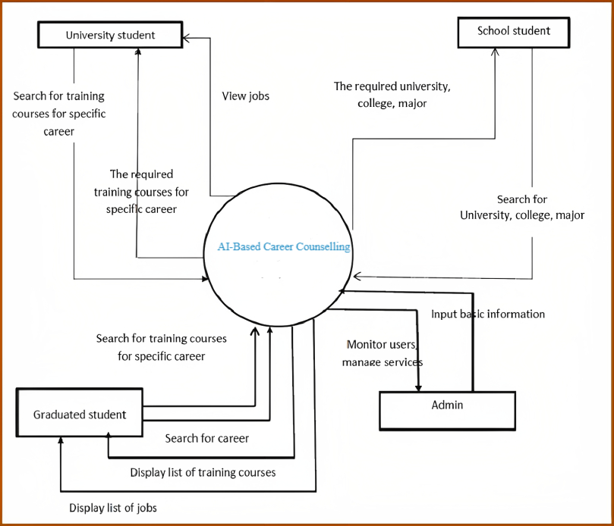
User Experience
Self-Assessment
Skill-Development
Career Management
Career Awareness
Goal-Setting

Slide 10
Potential for future work progression
Career counselling is set for a tremendous technological revolution where upskilling has been highlighted as the need of the hour. Intelligent Automation might just redesign the future of career counselling, and consequently, the future of job availability and higher education degrees.
AI has the ability to process large amounts of data from various sources in order to understand the customer’s preferences, needs and desires.
There are several advantages to it such as instant reply, cost effectiveness -compared to employing humans, self-learning, and no re-training required.
Thank You

